Slide 1
Programming Is Hard
Or at Least It Used to Be:
Educational Opportunities and Challenges
of AI Code Generation
Brett A. Becker Paul Denny James Finnie-Ansley Andrew Luxton-Reilly James Prather Eddie Antonio Santos
Meow!

Slide 2
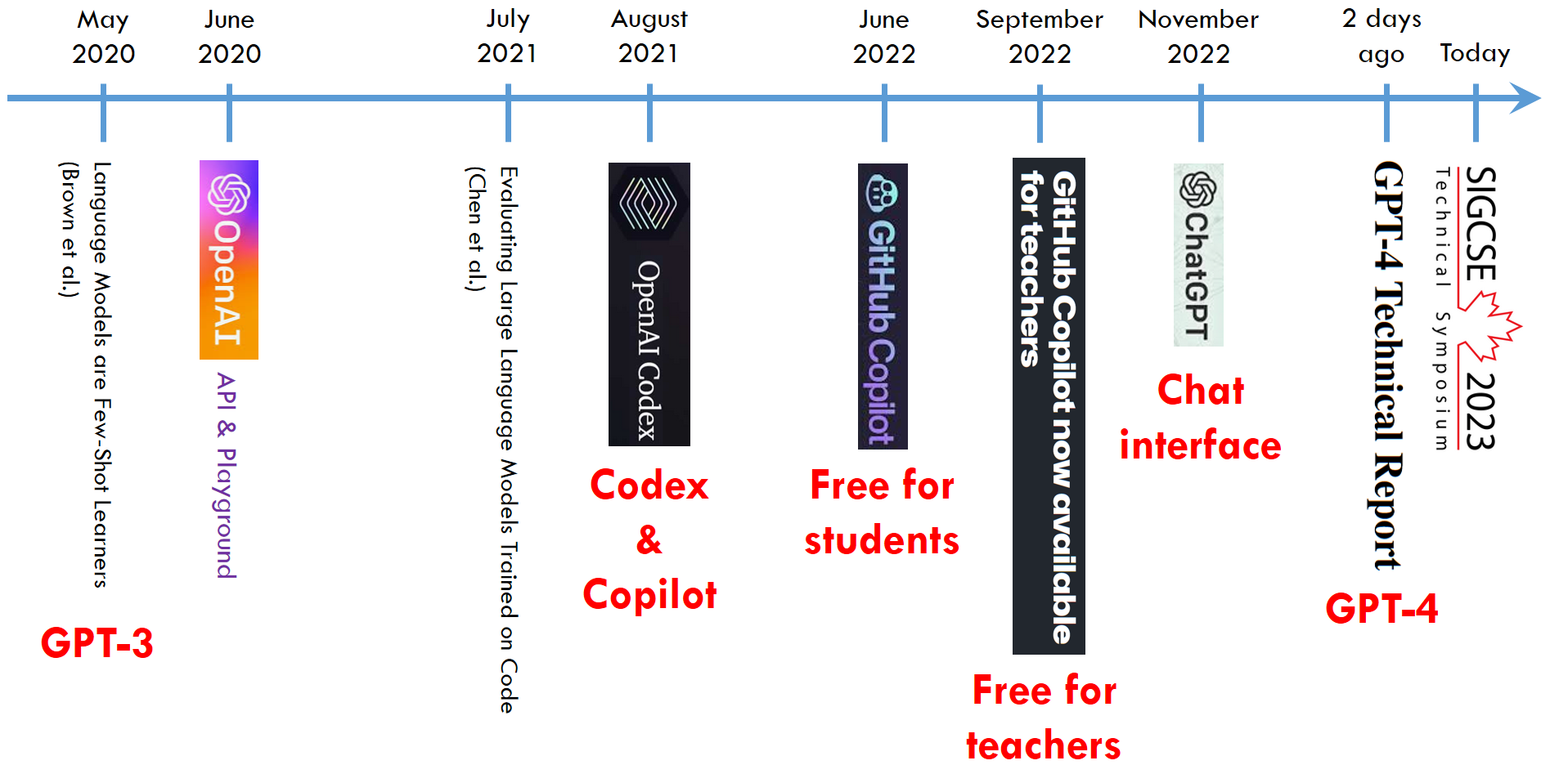
How did we get here so fast?
https://github.blog/2022-09-08-github-copilot-now-available-for-teachers/

Slide 3
What are we dealing with?
Most media attention has been on
text -> text (chat, essays, natural-language exams, etc.)
text -> image (e.g. Dall⬝E 2)
text -> video
text -> music
etc.
We have been interested in
text -> code
code -> text
code -> code
And other things like
code + programming error messages -> text/code
code + text -> text/code
etc.
In other words, anything that involves code in/out of LLMs

Slide 4
What do we care about?
Immediate or short-term challenges & opportunities in programming
Pedagogy
Curriculum
Practice
Culture
…
+ Slightly longer-term (so, likely-ish) Directions, Trends, Dynamics in the above areas
- Looking further and further ahead gets fuzzier and fuzzier

Slide 5
What do we know?
Large Language Models are good at working with (basic-ish) code
several CS1 & CS2 experiments show Codex performs in top quartile of real students
Good at working with a mix of code and natural language
Available (often free)
Being used by students & educators
Improving rapidly
Diversifying in their modes of access, interaction and purpose
Web interfaces
Apps
APIs
IDE plugins
…

Slide 6
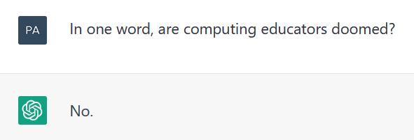
Challenges

Slide 7
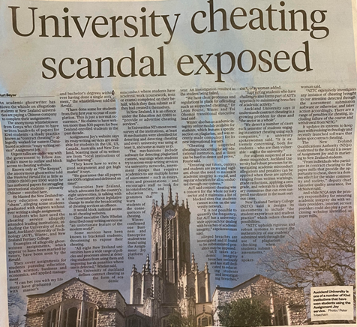
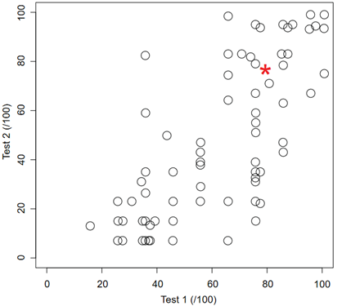
Challenges
Academic misconduct
Low-risk (high-reward)
“The Robots are Coming” (ACE 2022)

Slide 8
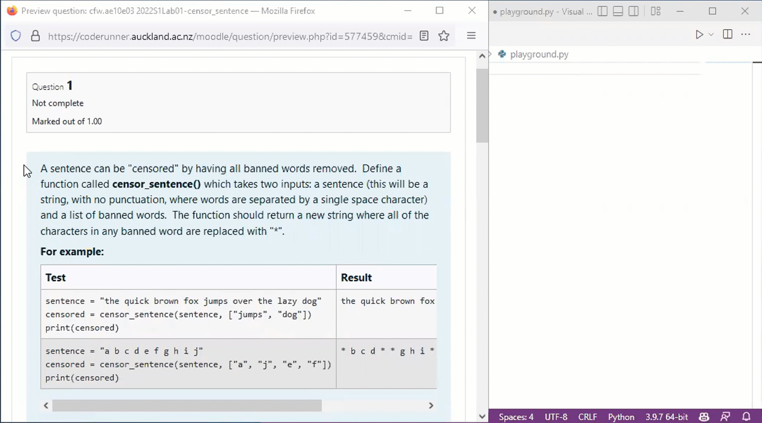
Challenges
Academic integrity

Slide 9
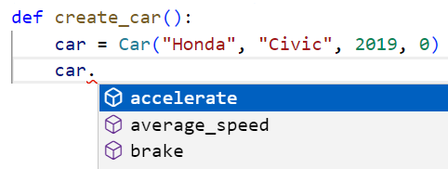
Challenges
Attribution
The “slow accept”
Blurred lines

Slide 10
Challenges
Bias and harmful outputs
Appropriate code for novices?
Codex “can be prompted in ways that generate racist, denigratory, and otherwise harmful outputs as code comments” (Chen et al. 2021)
“Computer science academics enjoying coffee at a conference coffee break”

Slide 11
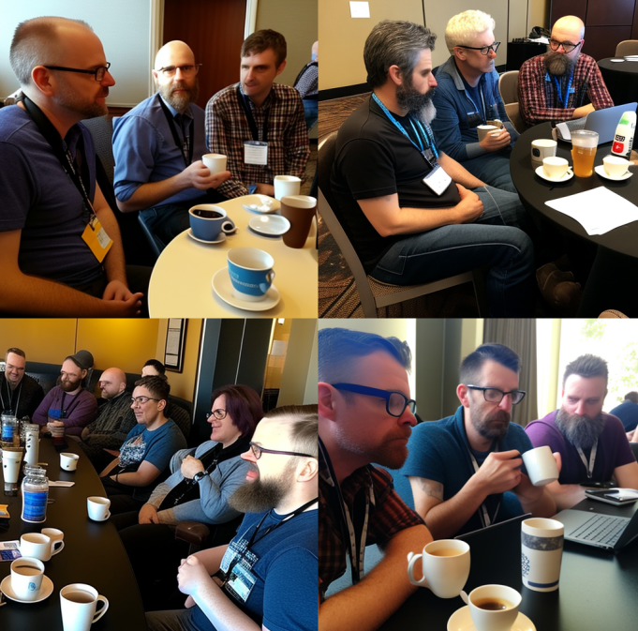
Challenges
Bias and harmful outputs
Appropriate code for novices?
Codex “can be prompted in ways that generate racist, denigratory, and otherwise harmful outputs as code comments” (Chen et al. 2021)

Slide 12
Challenges
Over-reliance
“This could particularly affect novice programmers” (Chen et al. 2021)
Student interviews:
“If someone is using it all of the time, then they’re not actually processing what’s going on, just hitting tab, and they don’t know what exactly they’re implementing.”
“It would make me a worse problem solver because I’m relying on it to help me out.”

Slide 13
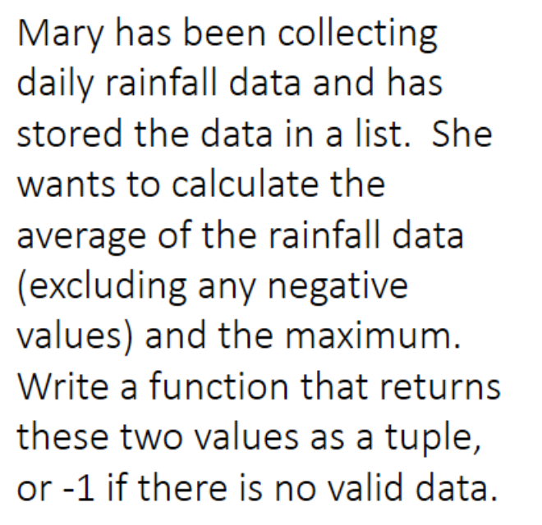
Opportunities
produce unlimited example solutions
idiomatic, showcases different problem solving styles

Slide 14
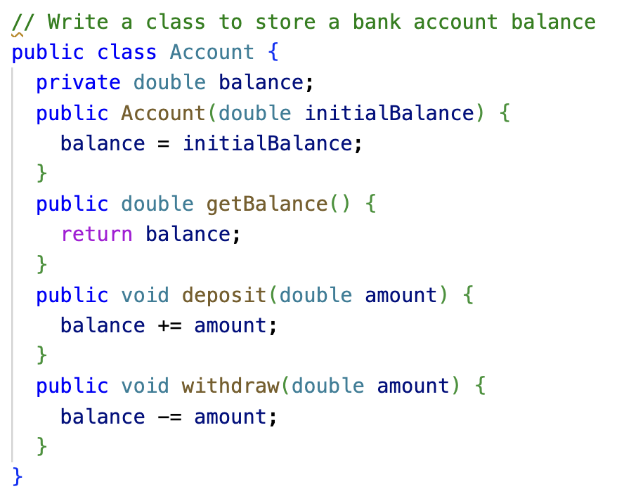
Opportunities
generate code for review
LLMs are confidently wrong — exploit this

Slide 15
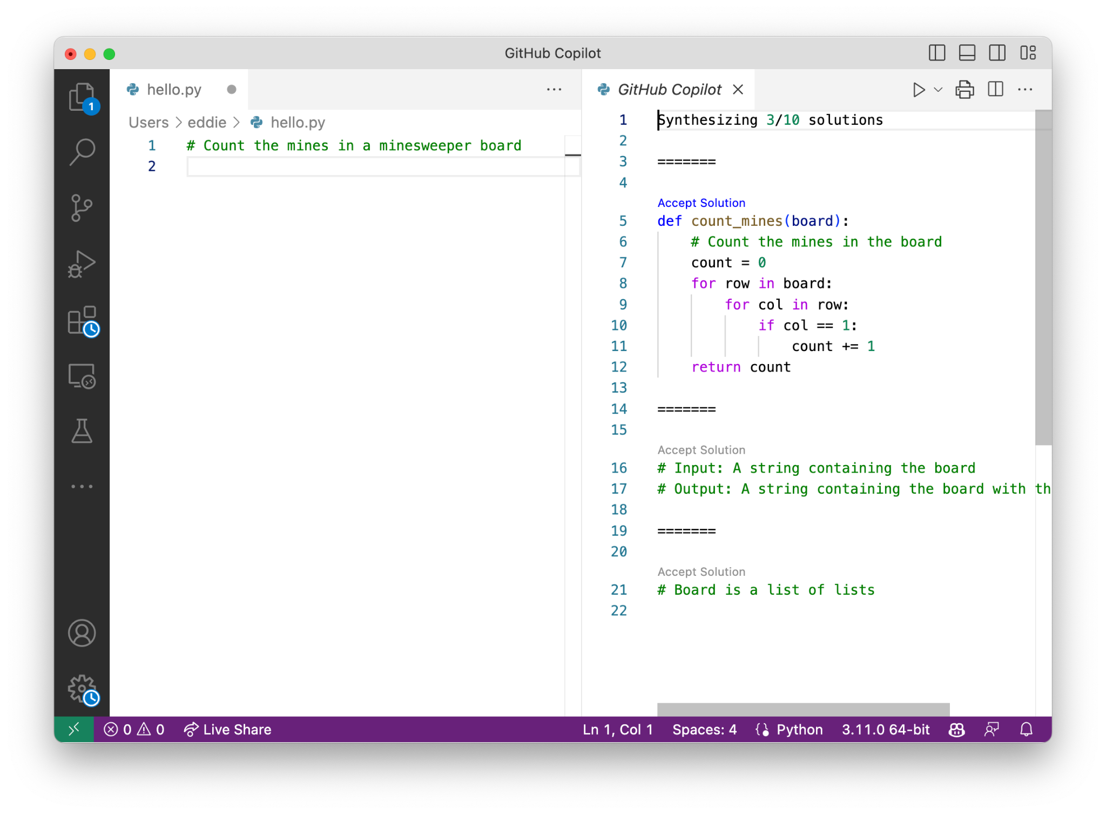
Opportunities
solve “blank page” syndrome

Slide 16
Opportunities
solve “blank page” syndrome

Slide 17
Opportunities

Slide 18
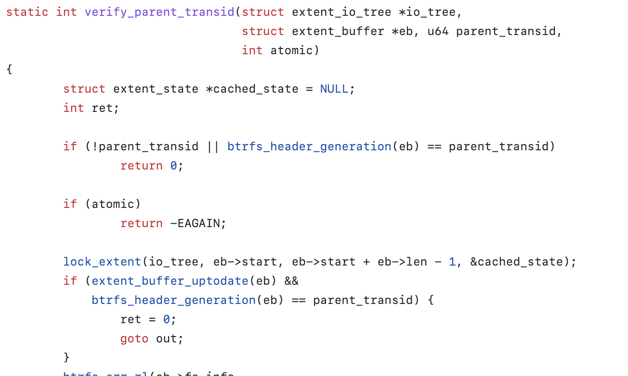
Opportunities: new, pedagogical approaches!
more authentic tasks — evaluate, modifying, extend existing code

Slide 19
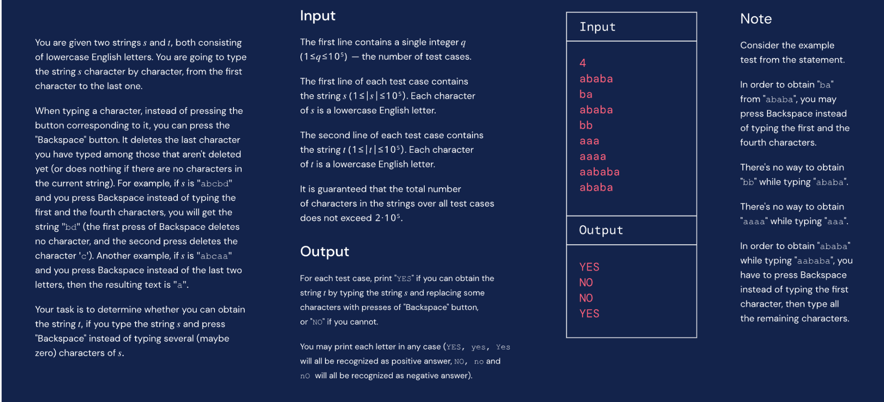
Opportunities: new, pedagogical approaches!
explaining algorithmic concepts clearly
easier for human to understand ⇒ easier for LLM to generate code

Slide 20
Opportunities

Slide 21
Future
Shaping Pedagogy:
While the capabilities of LLMs are now well known (pretty good!), there’s a need to know how students use and interact with these tools.
Curricular initiatives:
How can use utilize LLMs in the classroom? How can we create assignments that are not easily solved by LLMs? How can we still measure learning?
Educational tool development - how and when to expose LLM feedback into programming environments?
ITiCSE WG4: WG 4: Transformed by Transformers: Navigating the AI Coding Revolution for CS Education
Looking at the implications of LLMs for computing education
https://iticse.acm.org/2023/working-groups/

Slide 22
Recent work
ACE
The Robots Are Coming: Exploring the Implications of OpenAI Codex on Introductory Programming ACE '22 Best Research Paper Award
My AI Wants to Know if This Will Be On the Exam: Testing OpenAI's Codex on CS2 Programming Exercises ACE '23 Best Research Paper Award
ICER 22
Automatic Generation of Programming Exercises and Code Explanations Using Large Language Models Best Paper Award
SIGCSE 23
Programming Is Hard - Or at Least It Used to Be: Educational Opportunities And Challenges of AI Code Generation Best Position and Curricula Initiative Paper Award
Using Large Language Models to Enhance Programming Error Messages

Slide 23
Thank you!
Questions?

